Slide 1


DESIGN THINKING IN BUSINESS AND THE 31 MODEL WEEK 3

Slide 2
Agenda
Design Thinking in Business
3 Imodel

Slide 3

Weekly Concept Checklist

Slide 4
Group Discussion-working in your new groups

Slide 5
Reflection
Over the last two weeks, we have reflected on the importance of empathy. Using your understanding of empathy, outline how organisations can use empathy to support their workforce?
What were the critical takeaway messages from the empathy videos?

Slide 6
This How organizations can be empathetic Human Centred Organisations
Empower
Your People
Assessment 1

Slide 7
So what does Design Thinking for business entail?
Well, whilst there is a wide array of definitions and descriptions of DT , which are constantly changing, here are some of the common references that you will come across:
An approach to collaborative problem solving
An alternative approach to solving complex organisational problems
A mind –set for curiosity and inquiry
A fixed process and toolkit
A culture that recognises exploration an experimentation
A management buzz word sold as the ‘ next ‘strategic tool
A marketing slogan or tagline
All said and done could it be could it be just a new management buzzword that is marketed as the next being strategic tool!

Slide 8
The Emergence of DT as a Business Strategy Framework
A world dominated by speed and fluidity
Increased agility by businesses
Flexible organisation boundaries
Emergence of intrapreuners
Increasing role of creativity
Importance of the notion of Profit with a purpose

Slide 9
Design Thinking Challenge 1

Slide 10
Class Open Discussion-Individual

Slide 11
Pre-Tutorial Activity
Ikea is a good example of an organization that is human centered in its approach to conducting business.
Your Task
How does IKEA demonstrate being human centered in its approach?

Slide 12
Weekly Concept Checklist

Slide 13

DT versus Traditional Business

Slide 14
Class Discussion-What are your reflections on the differences outlined?

Slide 15
Reflection on Design Thinking and Practice in Business

Slide 16
Weekly Concept Checklist

Slide 17
De-mystifying Design Thinking for Creativity Tim Brown, CEO and President of IDEO
https://www.youtube.com/watch?v=U-hzefHdAMk

Slide 18
Design Thinking In Action
IDEO
IDEO is regarded as one of the pioneer firms that extended the use of Design Thinking to the business discipline. The boutique firm has since grown to be a leading voice in DT in business.
The company has used DT to address diverse business problems ranging from developing a consumer behaviour model for encouraging savings for clients of the Bank of America to designing solution that encouraged new ideas for a leading health care provider.
In all its cases , IDEO’s emphasis is on ensuring that responses to customer needs and the opportunities that emerged were human centric and they were various options developed.

Slide 19
IDEO AND DT
https://www.youtube.com/watch?v=GYkb6vfKMI4
https://www.youtube.com/watch?v=M66ZU2PCIcM

Slide 20
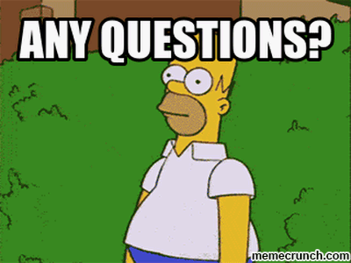
Any Questions On the Concepts Outlined

Slide 21
Weekly Concept Checklist

Slide 22
Group Discussion-working in your new groups

Slide 23

Case Study DT In Action

Slide 24
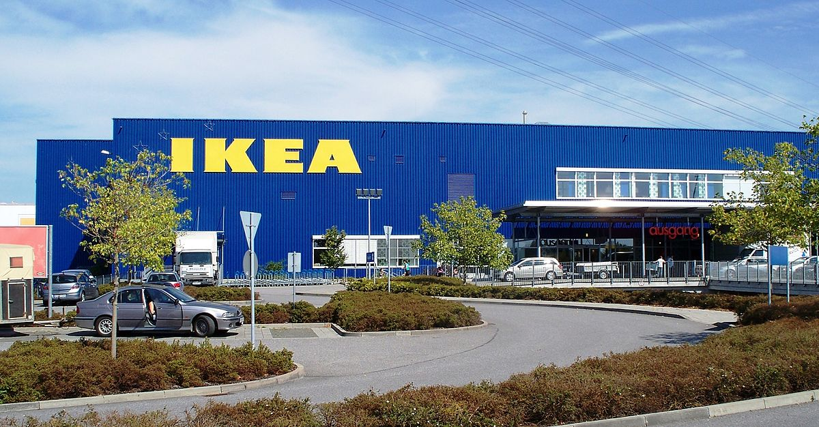
What Inspired IKEA
Let us look at the three core components of the Inspiration stage and evaluate how IKEA utilised them

Slide 25
The 3I Model-Human Centered Design Approach
Assessment 1
Inspiration
Ideation
Implementation

Slide 26
Inspiration

Slide 27
Inspiration-How IKEA demonstrates using inspiration
1.Lack of stylish affordable furniture
2. Demand for cheap functional modern household furniture
3.Changing consumer tastes
4.Being a small Swedish company-increasing competitors
1.Observed end-user needs in household furniture & global traits with middle class growth
2.Spending time with end-users to develop products
3.Variety of portfolio of products from basics to luxuries
1.Technology central to operations –automation, global supply chain network
2.Multidisciplinary
3.Open innovation collaboration-Lego,Addidas
4.Continuous internal trainig

Slide 28
Ikea and Technology team work
https://www.youtube.com/watch?v=Duub_dO_TwU
https://www.youtube.com/watch?v=wNqq6FSQy70

Slide 29
Inspiration Tools
1.Observation and register on place
This can be structured or unstructured, disguised or undisguised, natural or contrived, personal or mechanical, participant or non-participant.
2.Mind Maps and Information Maps
The process of mapping involves a logical organisation of complex information in a simplistic communicable visual format where patterns are established and meaning is extracted from a diverse set of data from sources such as literature review, observation or by interviews.

Slide 30
Ideation
IDEATION
Brainstorm

Slide 31
Tools for Idea Generation
Brainstorming
Brainstorming as a tool basically involves a participatory idea generation process where a large amount of ideas are produced within a short time and in most cases emotions and intuition are more important than rational thinking.
Sketching
Sketching is essential to making ideas tangible and concrete. Sketches can be through, simple drawing on a whiteboard where ideas are explained, clarified and discussed.
`

Slide 32
Design Thinking Challenge 1

Slide 33
Group Discussion-working in your new groups

Slide 34
Implementation

Slide 35
Tools for Implementation
Storyboard
Storyboards can evolve from the ideation stage and can be very important in outlining presentations to clients of a new product, a campaign, a new service or a new business which are central to any company’s growth.
Storytelling
Story telling plays a key role in providing an emotional narrative context of a new product or service which tends to be illustrative, symbolic and can create a memorable reminder of the product or service. The tool can be used with Role play to communicate a visual depiction of the product or service.
Using Role Play as a Test
A key form of a test would be a provisional launch targeting both launchers and customers, and should accommodate future further changes. A Role Play can be used where staff members interact with customers testing the new service or process. Record the session so that this can be used for future references.

Slide 36
DT in action

Slide 37
Mini Class Activity – Duration 40 minutes
Case scenario
Aussies embrace the culture of eating meat pie with ketchup on the top.
For example, in 7and 11 fuel station, they offer squeezed ketchup while
buying a meat pie.
The culture of eating has changed in the past one decade. Consumers are more aware of disposing off the packaging and recycling.
Your task
Use 3I model to change the squeeze ketchup packaging.
Inspiration
Ideation
Implementation

Slide 38


